Slide 1


JULIAN A. GRAJALES
10 FEBRUARY 2022
GitHub Project Material URL

Slide 2

Outline
Executive Summary
Introduction
Methodology
Results
Conclusion
Appendix

Slide 3
Executive Summary
Summary of methodologies
This project used public available information to train a machine learning model to predict if a first stage of a launching rocket will land successfully for future use. To do this training we used the following methodologies.
Data collection
Data wrangling
EDA with data visualization
EDA with SQL
Building an interactive map with Folium
Building a Dashboard with Plotly Dash
Predictive analysis (Classification)
Summary of results
Data collection and data wrangling of raw information
Perform exploratory data analysis and visual analytics of findings to train predictive models
Display EDA results by means of visualization and formal data presentation to assist in effective decision making processes

Slide 4
Introduction
Background and project context
The SpaceX Falcon 9 is advertised as a two-stage rocket that was
engineered to be efficient transporting people and payloads into space. Falcon 9
Is considered a reusable rocket, allowing the company to reuse key expensive rocket
stages to reduce cost during launches.
Problems to solve through this project
Determine the price of each launch.
Gathering of company information to create dashboards for different decision team.
Determine if SpaceX will reuse the first stage of Falcon 9 rocket.
Determine if the first stage will land successfully.

Slide 5

Section 1

Slide 6
Methodology
Data collection methodology:
Retrieve SpaceX API data of past results, perform get request to obtain launch data and normalize data to present findings.
Perform web scraping from HTML tables, parse the data to convert it into data frames for visualization and analysis
Transform raw data to provide meaningful data to solve the addressed questions.
Perform data wrangling
Data analysis to calculate the number of launches on each site
Calculate the number of launches on each site
Calculate the number and occurence of mission outcome per orbit type

Slide 7
Methodology
Perform exploratory data analysis (EDA) using visualization and SQL
Understand the Spacex DataSet
Load the dataset into the corresponding table in a Db2 database
Execute SQL queries to answer
Perform interactive visual analytics using Folium and Plotly Dash
Mark all launch sites, success/failed launches for each site and calculate the distances between a launch site to its proximities using Folium
Using Plotly Dash to build a real-time application for users to perform interactive visual analytics on SpaceX launch data.
Perform predictive analysis using classification models
Use of machine learning to determine successful landings of the first stage of Falcon 9.
Split the data into training data and test data to find the best Hyperparameter for SVM, Classification Trees, and Logistic Regression.
Find the method that performs best using test data.

Slide 8
Data Collection
Working data such as, launches, rocket used, payload delivered, launch and landing specifications, and landing outcome, proceeds from the SpaceX launching data gathered from the SpaceX REST API and public wiki pages.
The procured data is in the form of a list of JSON objects to represent each launch.
Data contained in the JSON will be normalized and structured into a flat table.
BeautifulSoup is used to web scrape html tables containing Falcon9 launch records.
Data will be parsed, sorted and organized to identify only the Falcon 9 launch information.
Get request
SpaceX REST API
Normalize
data
Assemble data into tables.
Save data in files such as .csv
Parse data
Web Scrape using Beautifulsoup

Slide 9
Data Collection – SpaceX API
GitHub Data Collection API
1. Define Get functions: getBoosterVersion(data) getLaunchSite(data)
getPayloadData(data) getCoreData(data)
2. Request rocket launch data from SpaceX API: spacex_url="https://api.spacexdata.com/v4/launches/past"
response = requests.get(spacex_url)
3. Decode response code as json() and turn it into panda dataframe: data=pd.json_normalize(response.json())
4. Construct dataset and convert into dictionary:
launch_dict = {'FlightNumber': list(data['flight_number’]), 'Date': list(data['date’]), 'BoosterVersion':BoosterVersion, 'PayloadMass':PayloadMass, 'Orbit':Orbit, 'LaunchSite':LaunchSite, 'Outcome':Outcome, 'Flights':Flights, 'GridFins':GridFins, 'Reused':Reused, 'Legs':Legs, LandingPad':LandingPad, 'Block':Block, 'ReusedCount':ReusedCount, 'Serial':Serial, 'Longitude': Longitude, 'Latitude': Latitude}

Slide 10
Data Collection - Scraping
Data Collection with Web Scraping
Request Falcon9 launch from Wiki pages:
static_url = https://en.wikipedia.org/w/index.php?title=List_of_Falcon_9_and_Falcon_Heavy_launches&oldid=1027686922
data = requests.get(static_url)
data.status_code
2. Create BeautifulSoup object and find all tables:
soup = BeautifulSoup(data.text, 'html.parser’)
html_tables = soup.find_all('table')
3. Apply find_all function using iterate ‘th’ to extract all column names.
4. Create an empty directory to with keys from extracted columns and then fill up the directory with data extracted from table rows.

Slide 11
Data Wrangling
Data Wrangling
Load Space X dataset and identify missing values in each informational attribute.
2. Calculate the number of launches on each site: df.LaunchSite.value_counts()
CCAFS SLC 40 = 55; KSC LC 39A = 22; VAFB SLC 4E = 13
3. Calculate the number and occurrence of each orbit: df.Orbit.value_counts()
- GTO 27 - ISS 21 - VLEO 14 - PO 9 - LEO 7 - SSO 5 - MEO 3 - GEO 1 - ES-L1 1 - SO 1 - HEO 1
Name: Orbit, dtype: int64
4. Calculate the number and occurence of mission outcome per orbit type:
Landing_outcomes = df.Outcome.value_counts()
for i,outcome in enumerate(Landing_outcomes.keys()):
print(i,outcome)
4. Create a landing outcome label from Outcome column:
landing_class = []
for key,value in df["Outcome"].items():
if value in bad_outcomes:
landing_class.append(0)
else:
landing_class.append(1)

Slide 12
EDA with Data Visualization
The following charts are used to present the information:
Scatter plots:
Flight Number vs. Payload Mass
Flight Number vs. Launch Site
Payload vs. Launch Site
Orbit vs. Flight Number
Payload vs. Orbit Type
Orbit vs. Payload Mass
Bar graph:
Mean vs. Orbit
Line Graph:
Success Rate vs. Year
The scatter plots display how one variable depends from other parameter.
The bar graph allows the comparison of the successful launch depending on its orbit.
The line graph gives us the trend of successful launches in time.
EDA with Data Visualization Github Notebook

Slide 13
EDA with SQL
The exploratory data analysis with SQL loaded the datasets into tables to extract key information and presented in a selective form as follows:
Displaying the names of the unique launch sites in the space mission
Displaying 5 records where launch sites begin with the string 'KSC’
Displaying the total payload mass carried by boosters launched by NASA (CRS)
Displaying average payload mass carried by booster version F9 v1.1
Listing the date where the successful landing outcome in drone ship was achieved.
Listing the names of the boosters which have success in ground pad and have payload mass greater than 4000 but less than 6000
Listing the total number of successful and failure mission outcomes
Listing the names of the booster_versions which have carried the maximum payload mass.
Listing the records which will display the month names, successful landing_outcomes in ground pad ,booster versions, launch_site for the months in year 2017
Ranking the count of successful landing_outcomes between the date 2010 06 04 and 2017 03 20 in descending order.
EDA with SQL notebook

Slide 14
Build an Interactive Map with Folium
To visualize the information with the interactive map, I processed the CSV dataset to extract the geographical coordinates of the sites used to launch the SpaceX Falcon 9 first stage rocket. All sites were marked with circles and labels of each launching sites.
The circles were added to identify the locations in the map regardless of the zooming scale using folium.circle. The visualization helped identify the sites located far from the equator line, but near the tropic where the rotational speed is lesser and safer to perform the launches.
Launches at each site were marked with green (1) or red (0) depending on the success or failure of the launch.
Interactive Map GitHub notebook

Slide 15
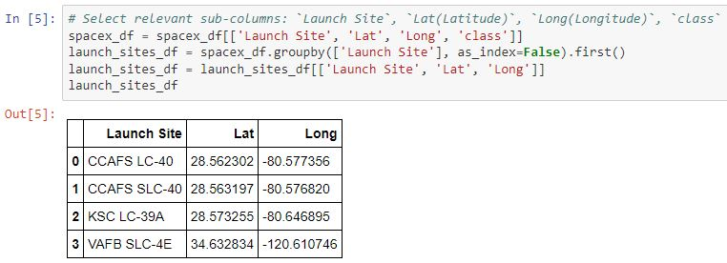
Interactive Map with Folium (continued)
Task 1: Mark all launch sites on a map

Slide 16
Build a Dashboard with Plotly Dash
I modified the pre-assembled template from Yan Luo and Joseph Santarcangelo to create an interactive dashboard to present the launching records of SpaceX. It has a drop-down menu, listing each of the launching pads, and all as a group, a pie chart with the presenting the success launching rates for the selected site, an slider ruler to customize the result and a scatter plot diagram displaying the payload vs class of booster version.
This plots enable the decision makers to discriminate the date in a visual manner and customizes the plots to filter the information depending of input parameters such as site, and payloads.
Interactive Dashboard with Ploty Dash GitHub notebook

Slide 17
Predictive Analysis (Classification)
To elaborate a predictive analysis, the dataset is used as follows:
Load data using Pandas dataframe and Numpy arry.
Standardize the data and transform it for analysis.
Split our data into training and test data sets, and list the amount of test samples.
Create a logistic regression object, a GridSearchCV object logreg, a support vector object, a decision tree classifier object, and a k nearest neighbors object to fit the objects, and find the best parameters.
Calculate the accuracy on the test data using the method score for each object.
Find the method performs best.
Machine Learning Prediction GitHub notebook

Slide 18
Results
Exploratory data analysis results
Interactive analytics demo in screenshots
Predictive analysis results

Slide 19

Section 2

Slide 20
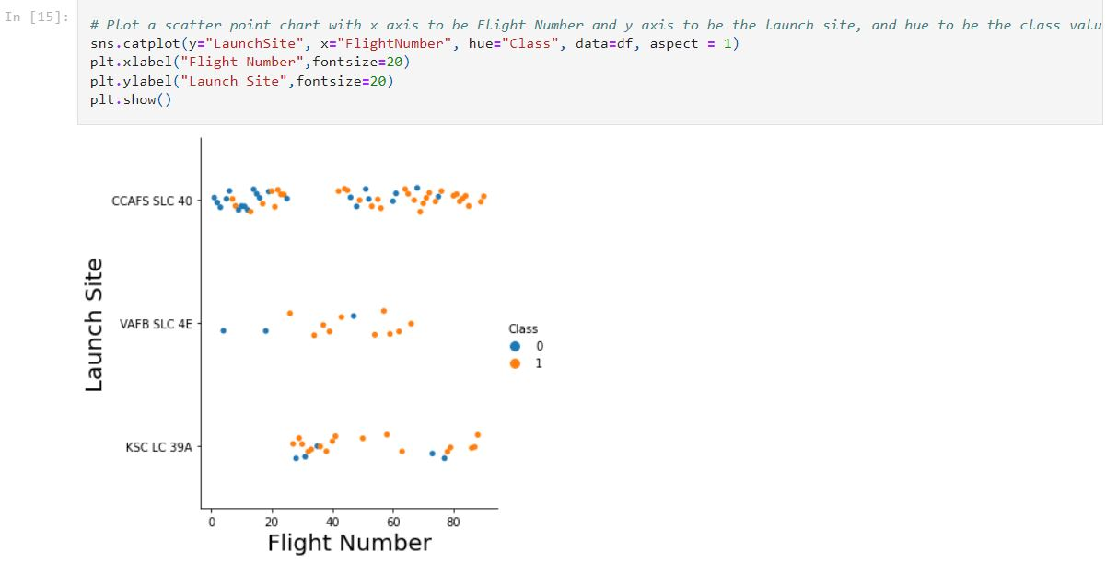
Flight Number vs. Launch Site
EDA with Data Visualization Flight number vs. launch site chart:
Shows CCAFS SL40 had more launches than the other two sites, and as flights increased, the successful rate of return increased in all sites.

Slide 21
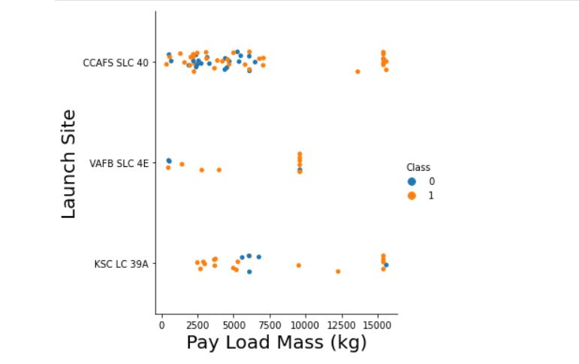
Payload vs. Launch Site
EDA with Data Visualization Payload mass vs. launch site chart:
Shows the max payload per site and the landing success per pay load at each site.

Slide 22
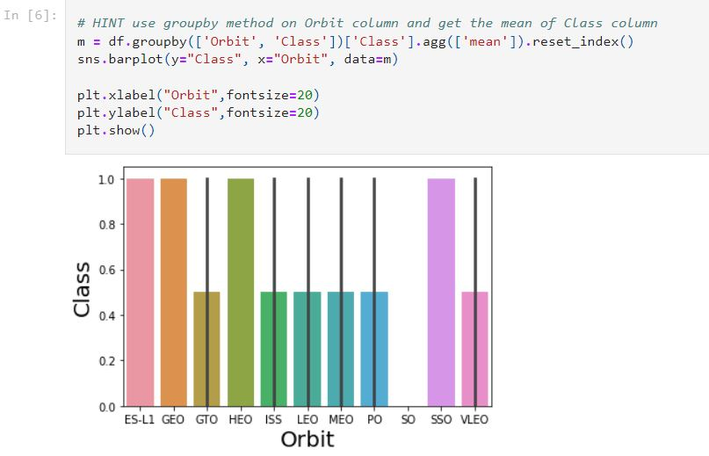
Success Rate vs. Orbit Type
EDA with Data Visualization Orbit vs. Class chart:
Indicates the rate of landing success per orbit.

Slide 23
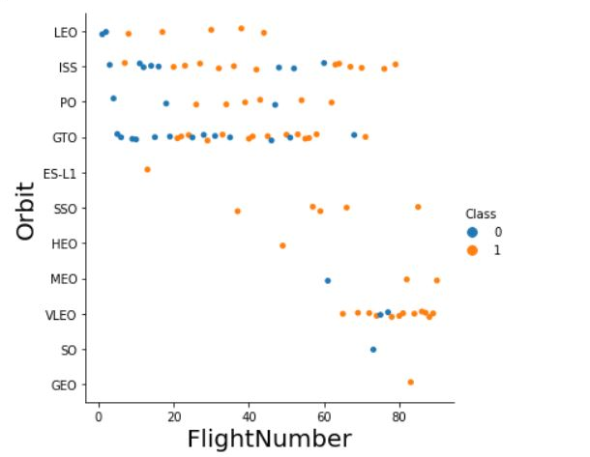
Flight Number vs. Orbit Type
EDA with Data Visualization Flight number vs. orbit chart:
Shows the what progression of landing success per orbit and the increasingly use of different orbit as the flights increases.

Slide 24
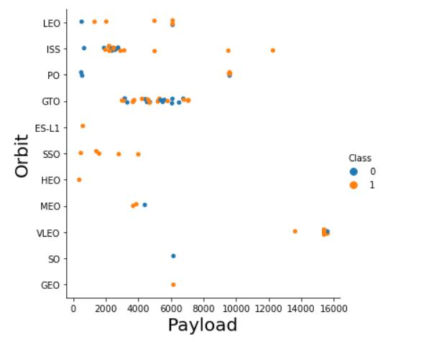
Payload vs. Orbit Type
EDA with Data Visualization Payload vs. Orbit chart:
This chart relates the increase of payload to successful landing per orbit.

Slide 25
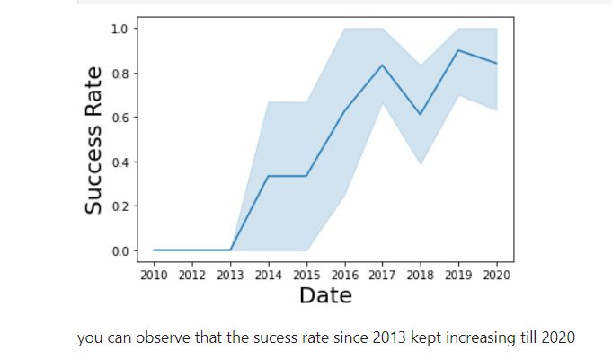
Launch Success Yearly Trend
EDA with Data Visualization Date vs. Success rate chart:
This graph shows the increase of average rate of successful landings as the project moves over time.

Slide 26
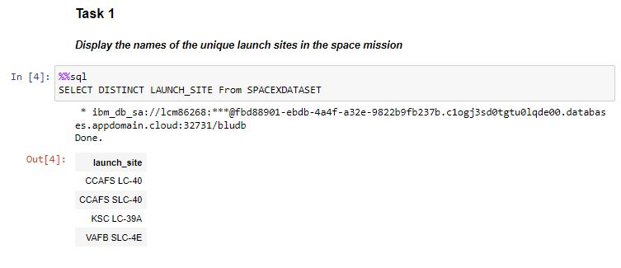
All Launch Site Names
Find the names of the unique launch sites
The query selects all names from the Launch_Site column and removes duplicate values by usint the DISTINCT function.

Slide 27
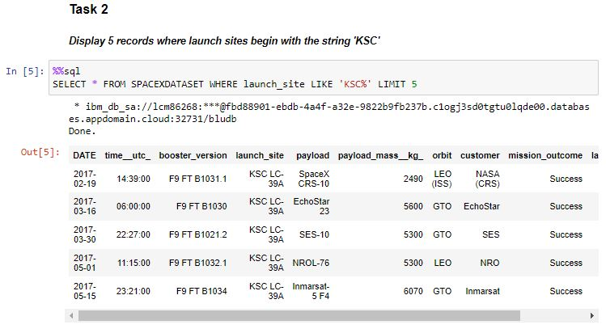
Launch Site Names Begin with 'KSC'
Find 5 records where launch sites’ names start with `KSC`
The selection processed all rows where the launch site name start with KSC.

Slide 28
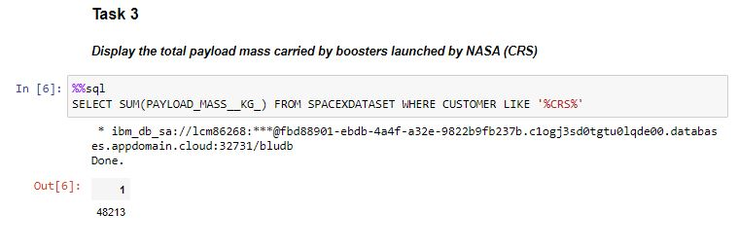
Total Payload Mass
Calculate the total payload carried by boosters from NASA
This selection sums all the values in the Payload mass column where the customer name contains CRS

Slide 29
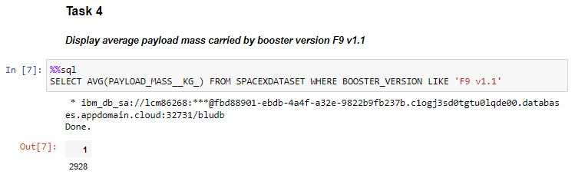
Average Payload Mass by F9 v1.1
Calculate the average payload mass carried by booster version F9 v1.1
The exercise calculate the average value from all values of Payload mass column on all rows where the booster version is equal to F9 v1.1

Slide 30
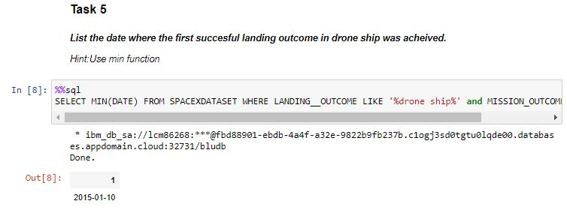
First Successful Ground Landing Date
Find the dates of the first successful landing outcome on ground pad
In this task, I selected the minimum (oldest) date from the dataset where both clauses are valid for drone name and successful landing.

Slide 31
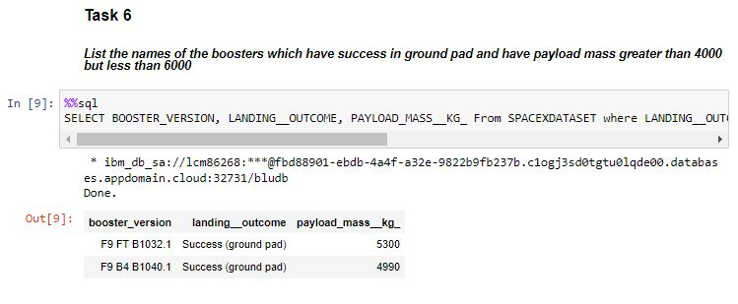
Successful Drone Ship Landing with Payload between 4000 and 6000
List the names of boosters which have successfully landed on drone ship and had payload mass greater than 4000 but less than 6000

Slide 32
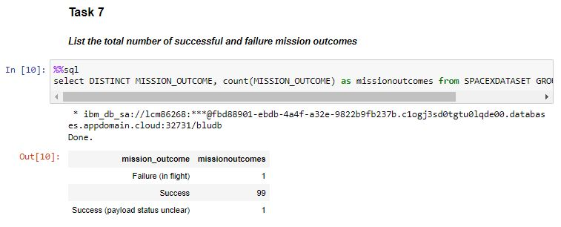
Total Number of Successful and Failure Mission Outcomes
Calculate the total number of successful and failure mission outcomes

Slide 33
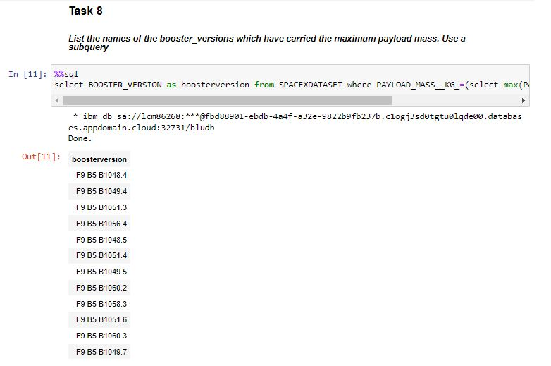
Boosters Carried Maximum Payload
List the names of the booster which have carried the maximum payload mass

Slide 34
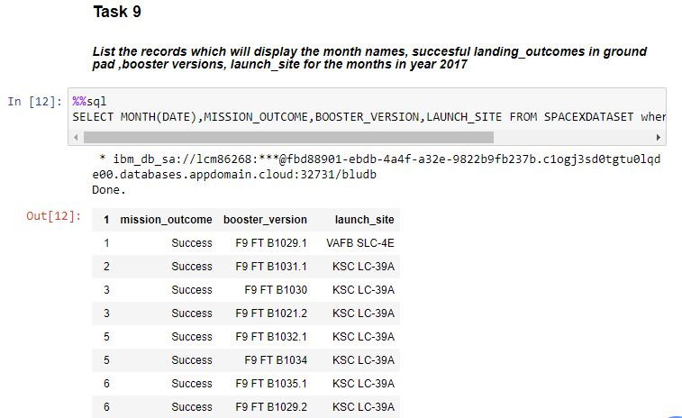
2015 Launch Records
List the records which will display the month names, succesful landing_outcomes in ground pad ,booster versions, launch_site for the months in year 2017.

Slide 35
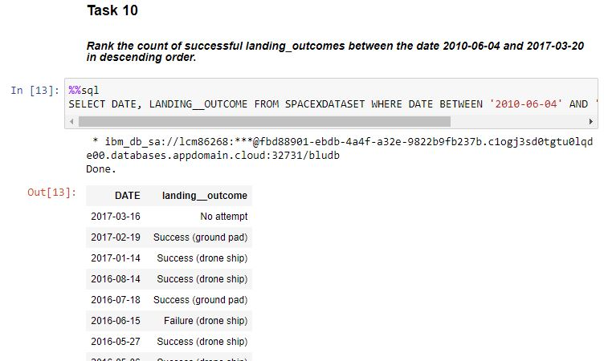
Rank Landing Outcomes Between 2010-06-04 and 2017-03-20
Rank the count of successful landing_outcomes between the date 2010-06-04 and 2017-03-20 in descending order.

Slide 36

Section 3

Slide 37
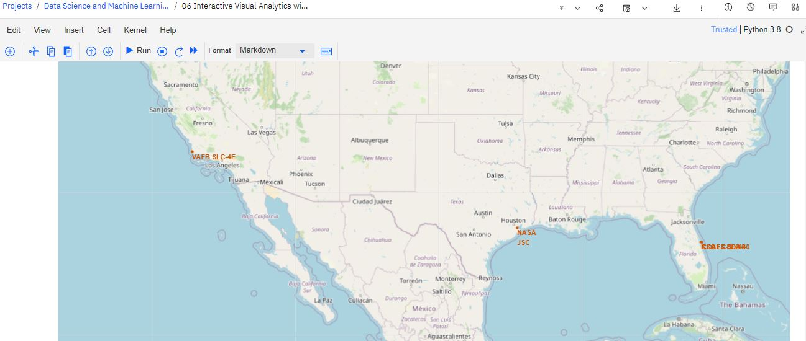
Markers in map for each of the launching sites
Are all launch sites in proximity to the Equator line? The launch sites are not in proximity to the equator line but to the northern tropic circle because the rotational speed is lesser at the tropic line due to safer winds speeds at the launch pad surfaces.
Are all launch sites in very close proximity to the coast? Yes, in case of mishaps or launch failures, rockets may be directed to the ocean, instead of populated areas surrounding a launch site in the inner lands.

Slide 38
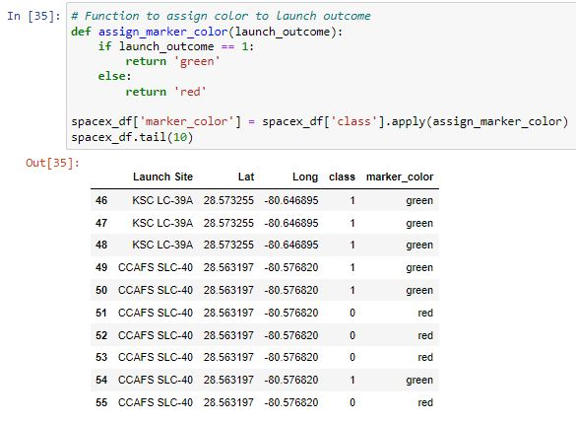
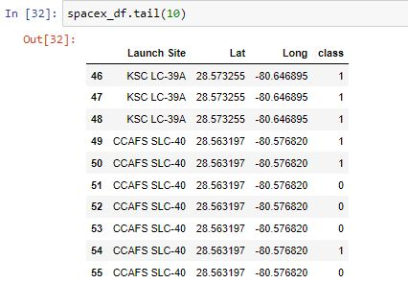
Mark the success/failed launches for each site on the map

Slide 39
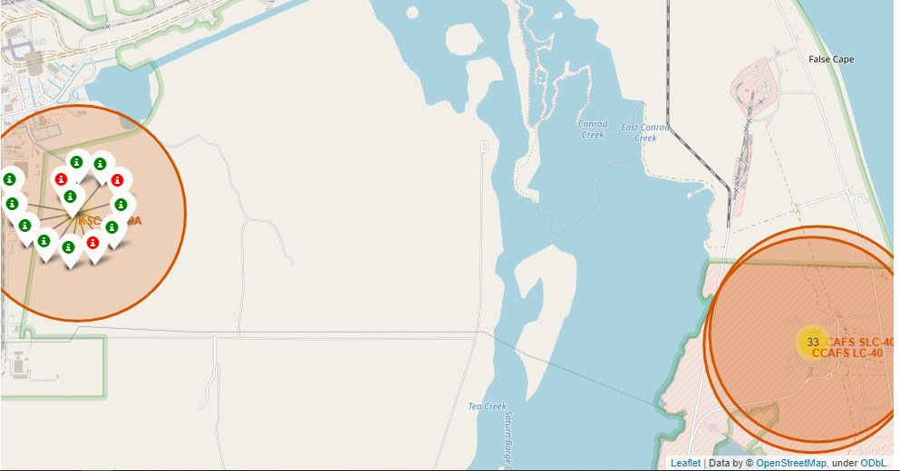
Marker cluster for each of the launching sites
Each site has been marked with a cluster indicating the amount of launches and a color code designation of the amount of successful and failed launches represented by green and red markers respectively.

Slide 40
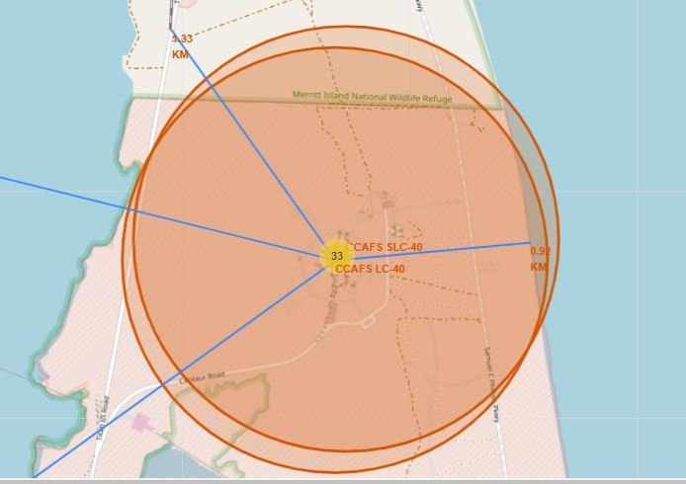
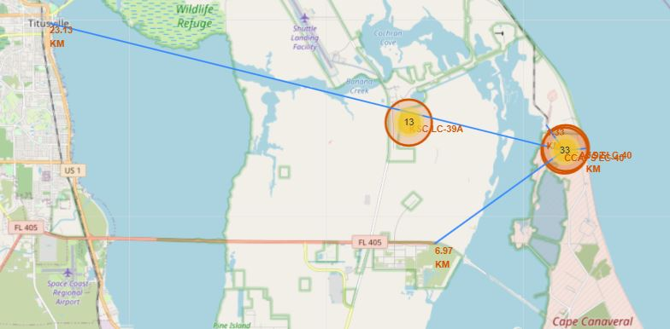
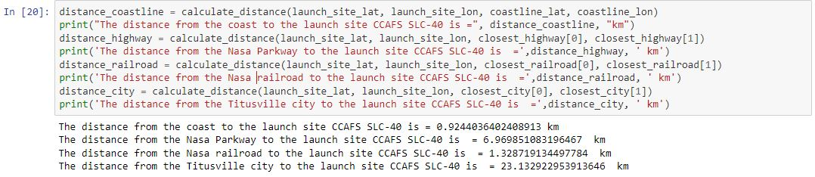
Distances between a launch site to its landmark proximities

Slide 41

Section 4

Slide 42
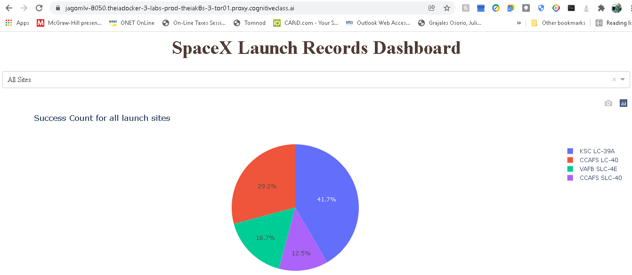
Distribution of success count of launch records for all sites
TASK 2: Callback function to render success-pie-chart based on selected site dropdown

Slide 43
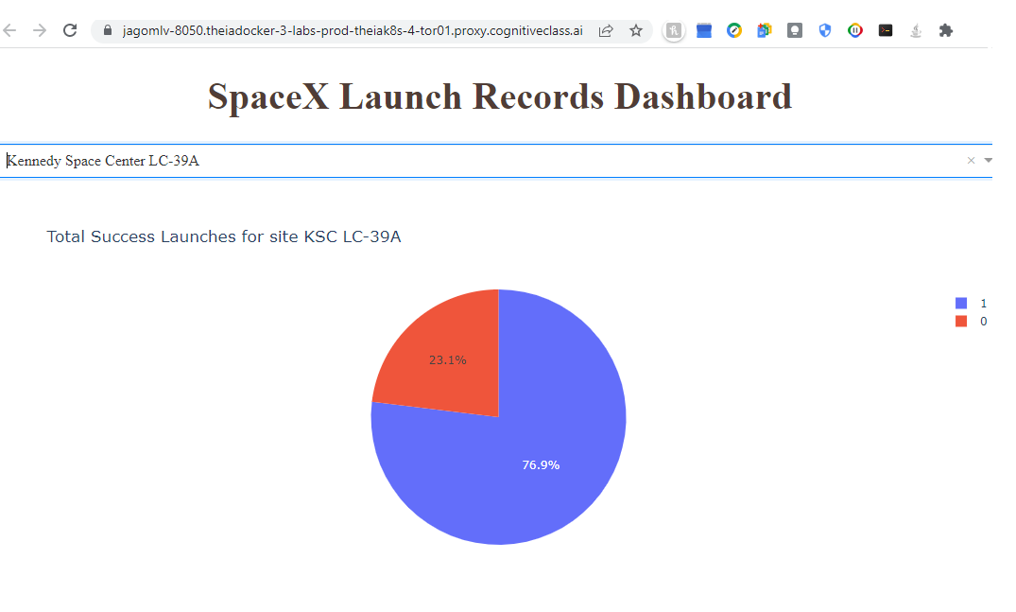
Space X Launch Records Dashboard.
Launch site with highest launch success ratio.

Slide 44
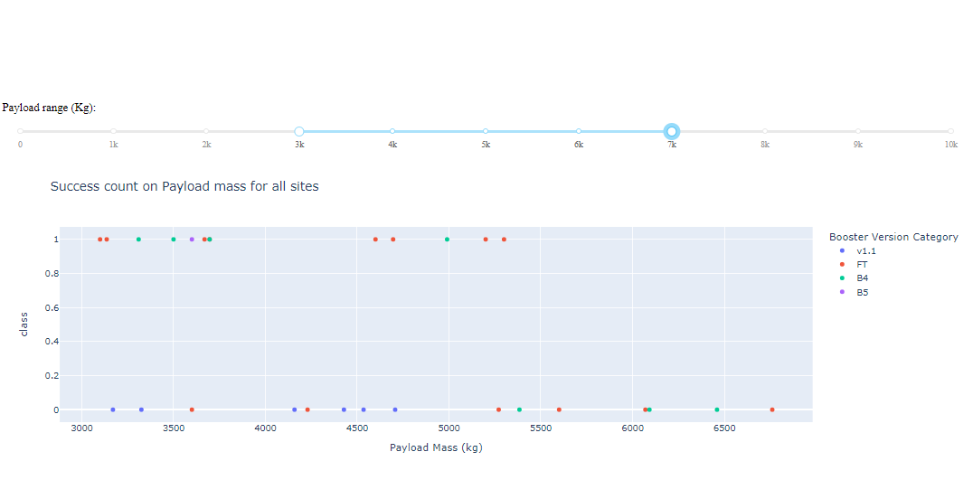
Success count of payload mass between 3000 and 7000 kg from all sites

Slide 45

Section 5

Slide 46
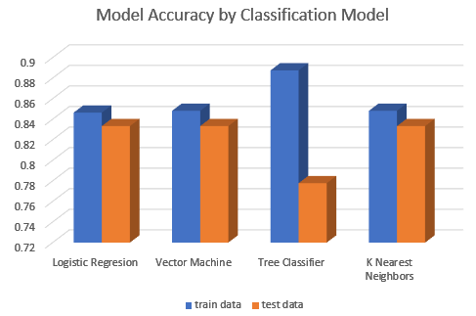
Classification Accuracy

Slide 47
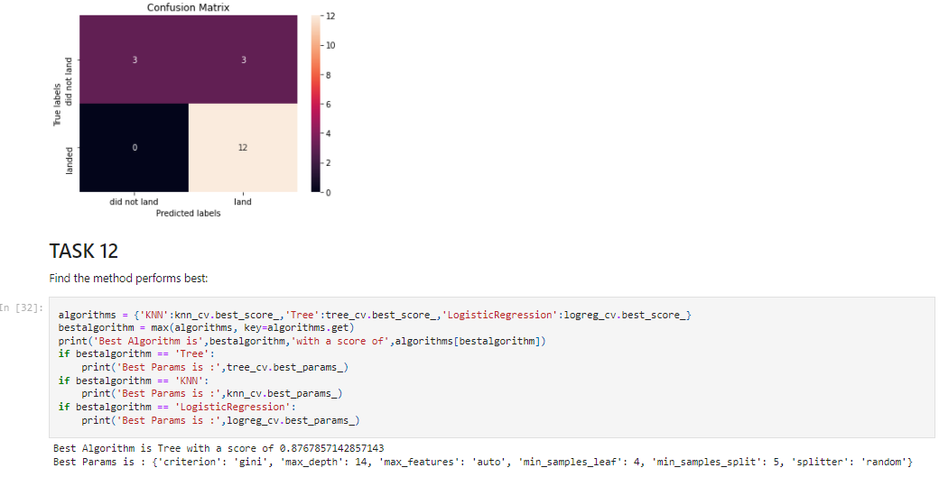
Confusion Matrix

Slide 48
Conclusions
Each site had increased success as the flight number count increased.
Weight is a key element on the successful launches, the lighter the booster is, the better it performs.
SpaceX launches got better with the passing of time, considering past results as the program evolves in time.
The sites in Florida had the highest and lowest successful launch rates of all sites. Kennedy Space Center was the most successful and Cape Canaveral was the least successful sites.
Best Algorithm is Tree classifier algorithm, with a score of 0.8767857142857143
All sites were located in coastal areas, at about the tropical circle latitude.

Slide 49
Appendix
Skill Network Lab for plotly notebook.
IBM Cloud Pack for Data notebooks.
GitHub training upload and example files.
CSV files using Microsoft Excel.

Slide 50


